Slide 1

KING COUNTY REAL ESTATE
Grace Arina, Justin Sohn and Anthony Warren

Slide 2
Overview
Business Problem
Data & Methods
Results
Recommendations

Slide 3

Business Problem
Stakeholders:
First time home buyers
Home-sellers
Folks in the tech industry
Analysis Questions:
What are the aspects/features that best determine the price of a home?
When’s the best/worst time of the year to buy/sell a home, in terms of price?
Is there a relationship between house price and the distance from downtown Seattle and downtown Redmond
Which features are strongly related with each other?

Slide 4
DATA & METHODS
The King County Housing Data Set contains information about the price, size, location, condition and other features of houses in the Washington’s King County area.
After data cleaning:
21,597 house sales between May 2014 – May 2015
21 variables

Slide 5
SUMMARY
The total square footage, grade and latitude are the best predictors of a home price in King County.
The best time to sell a home is in late spring/early summer
There is a negative association between home price and the distance from downtown Redmond and Seattle, meaning that the home prices went down further from downtown.

Slide 6
INFERENTIAL MODEL
The further up north in King County the home is located, the higher the price of the home with a coefficient of $141,214 with each increase of latitude
Each additional square footage of living space in the home is associated with an increase of $249 in price
Notes:
The further up north in King County the home is located, the higher the price of the home with a coefficient of $141,214 with each increase of latitude
Each additional square footage of living space in the home is associated with an increase of $249 in price
Each additional bedroom is associated with a decrease of $46,098 in the price of a home
Each additional bathroom is associated with an increase of $10,629 in the price of a home
The age of the home, yr_built, has a negative association with price with a decrease of $3,392 per year

Slide 7
R-Squared Improvement Over the FOUR Models
The final model can account for about 80.2% of the variability in price and the test root mean squared error is $164,842.
Our metrics for R-squared and RMSE have improved over iterations from our basic model to our final model, allowing us to predict better results each time.

Slide 8
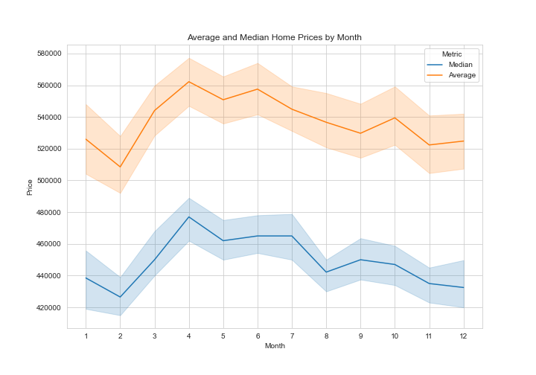
Home PRICES by Month/Season
Average and median sale prices were the highest between April-June, while the opposite is true between November-February
Housing price can be affected by time/season

Slide 9
Geographical FACTOR
Higher Prices:
Houses between downtown Seattle and downtown Redmond tend to have higher prices
Tend to be clustered
Near water area
Lower Prices:
Tend to be spread out
Houses in the southern part of King County have lower prices

Slide 10
HOME QUALITY
Houses with grade equal to or higher than 9 have higher prices than the others

Slide 11
RECOMMENDATIONS
For Homebuyers:
Square footage of living space - To save money, consider purchasing a home with less square footage
For Home-sellers:
Building Grade - Fix up the house by improving quality of materials when buying and re-modelling to sell at a higher price later on
For those in the tech industry:
Geographical Factor - Look at homes outside of the downtown areas for more affordable homes
Age of the home - Look into purchasing older homes as they tend to be less expensive the older they are.

Slide 12
THANK YOU!
Feel free to reach out to us if you have any questions
Contacts
Grace Arina: g.boinz@gmail.com
Justin Sohn: jusohn2015@gmail.com
Anthony Warren: anthonywarren6@gmail.com

Slide 13

qUESTIONS

